Slide 1
Fashion-MNIST Classification
Gurpreetsingh Gill – P2939747
Msc Artifical intelligence
13 November 2025

Slide 2
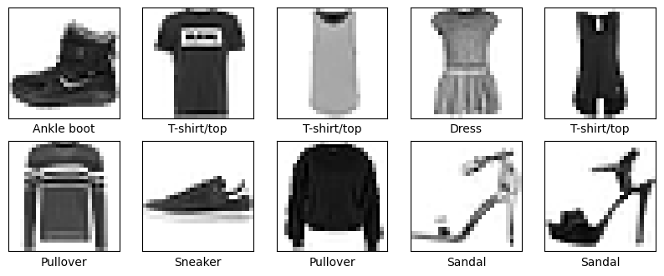
Introduction
Fashion-MNIST: dataset of 70,000 grayscale images of 10 clothing categories.
Topic chosen to explore neural networks’ performance on image classification.
Problem addressed: accurately classifying clothing items and understanding model performance on visually similar classes.

Slide 3
Objectives / Goals
Implement and compare ANN (MLP) and CNN architectures for classification.
Evaluate overall performance, generalization, and class-wise accuracy.
Identify confusion patterns and recommend strategies to improve classification.

Slide 4
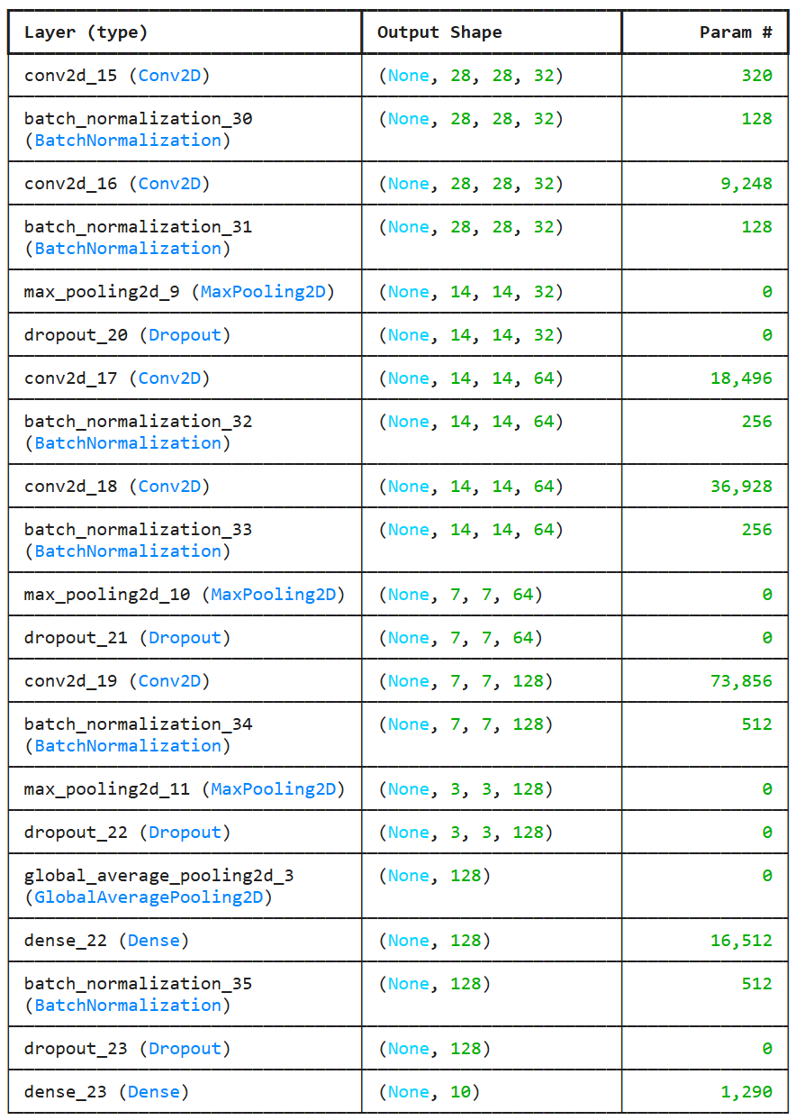
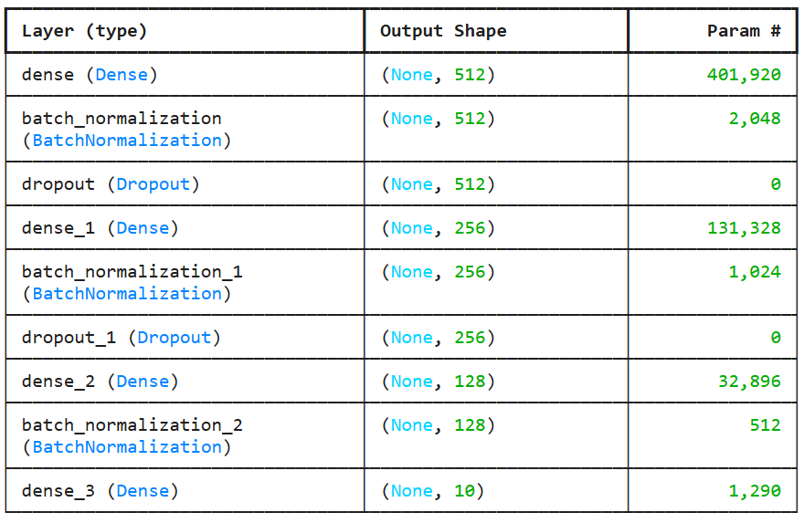
Methodology
ANN: Dense layers (512 → 256 → 128), ReLU, Dropout, Batch Normalization.
CNN: Convolutional blocks (32→64→128 filters), BatchNorm, MaxPooling, GlobalAveragePooling, Dropout.
Optimizer: Adam Loss: Categorical Crossentropy
ANN Model Structure
CNN Model Structure

Slide 5
Data / Materials / Inputs
Data: Fashion-MNIST (60,000 training, 10,000 test).
Preprocessing: Normalization, split into training, validation, and test sets.

Slide 6
Implementation / Process
.
Step 1: Load and preprocess data.
Step 2: Design ANN and CNN architectures.
Step 3: Compile models with Adam optimizer and categorical crossentropy.
Step 4: Train models with validation monitoring.
Step 5: Evaluate on test set; generate confusion matrices

Slide 7
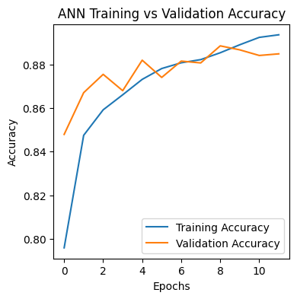
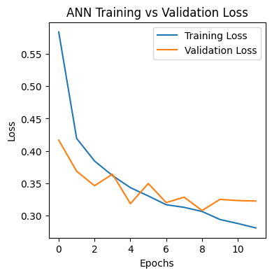
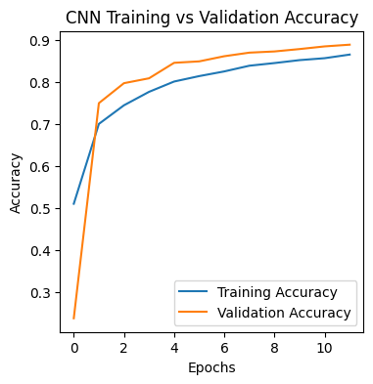
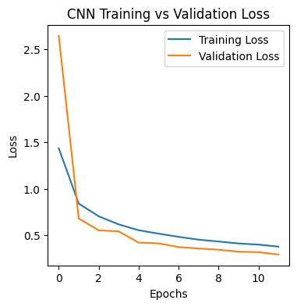
Results / Findings

Slide 8
Discussion / Interpretation
CNN’s convolutional filters capture general patterns, improving test accuracy.
ANN shows stable learning, smaller train-validation gap, slightly weaker generalization.
Upper-body classes are confused due to overlapping visual features; Shoes, Bags easily distinguished.
Accuracy/loss curves support that CNN generalizes well without severe overfitting.

Slide 9
Conclusion / Summary
CNN is preferred for deployment due to higher test accuracy and generalization.
ANN performs well but struggles with fine-grained class separation.
Systematic confusion highlights opportunities for targeted improvements.
Project demonstrates practical implementation of ANN and CNN on Fashion-MNIST dataset.

Slide 10
Future Work / Acknowledgments
Future Work
Apply class weighting or focal loss for underperforming classes.
Upsample images to capture finer details.
Use Data Augmentation
Acknowledgments
Keras
TensorFlow
Fashion-MNIST dataset
Instructors

